Slide 1

PROBABILITY
By
Saujanna Jafreen
Lecturer
Department of Natural Sciences

Slide 2
Probability
Objectives:
At the end of the session the participants should be able to:
i. Define trial/experiment and event
ii. Define probability.
iii. State the properties of probability and probability rules
iv. Compute probability of events.

Slide 3
Definition
Trial/Experiment:
Any planned activity or process that result in some definite outcome is called Trial or Experiment.
Event: Outcome is called Event.
eg.
(1) Coin tossing is a trial or experiment
‘Head’ or ’Tail’ – outcome/event
(2)Throwing a die
1,2,3,4,5,6 - event
(3) Occurring a disease - trial.
Disease ‘occurred’, ‘Not Occurred’ - event.

Slide 4
In the football game- Trail
-win or loss – Event.

Slide 5
Characteristics of events
    Mutually exclusive
    Exhaustive
Mutually exclusive
One and only one outcome can happen out of a single trial.
- If one outcome happens than other outcome(s) will not happen or in other words Two or more outcomes cannot happen at a time].
Example: let us consider, a coin is tossed. There are two possible outcomes: Head and Tail. In any toss (trial) it will be either Head or Tail. Both Head and Tail cannot happen simultaneously.

Slide 6
Exhaustive
All possible outcomes together is called “Exhaustive”.
Equally likely
If probability of getting Head(H) and Tail(T) is equal , then H and T are called equally likely event.
Example : For a coin toss P(H)=P(T)=0.5; if a coin is unbiased.

Slide 7
Independence of Events
If A and B are two events and if the occurrence of A does not affect , and is not affected by the occurrence of B, then A and B are said to be independent.
P(A and B)= P(A) * P(B)

Slide 8
Non-independence of Events
Events A and B are said to be Dependent (or not independent) if occurrence of either of the events A and B will influence the other.
P(A and B) ≠ P(A) * P(B)

Slide 9
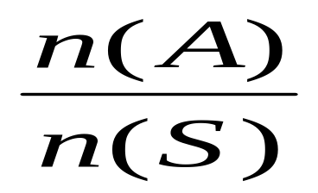
Definition
  If an experiment has a total no of n(s) possible outcomes , all of which are mutually exclusive and equally likely , such that n(A) of the outcomes are favorable to an event A , then the probability of the event A is defined by-
P(A)=
favorable outcome
=
total no of outcomes

Slide 10
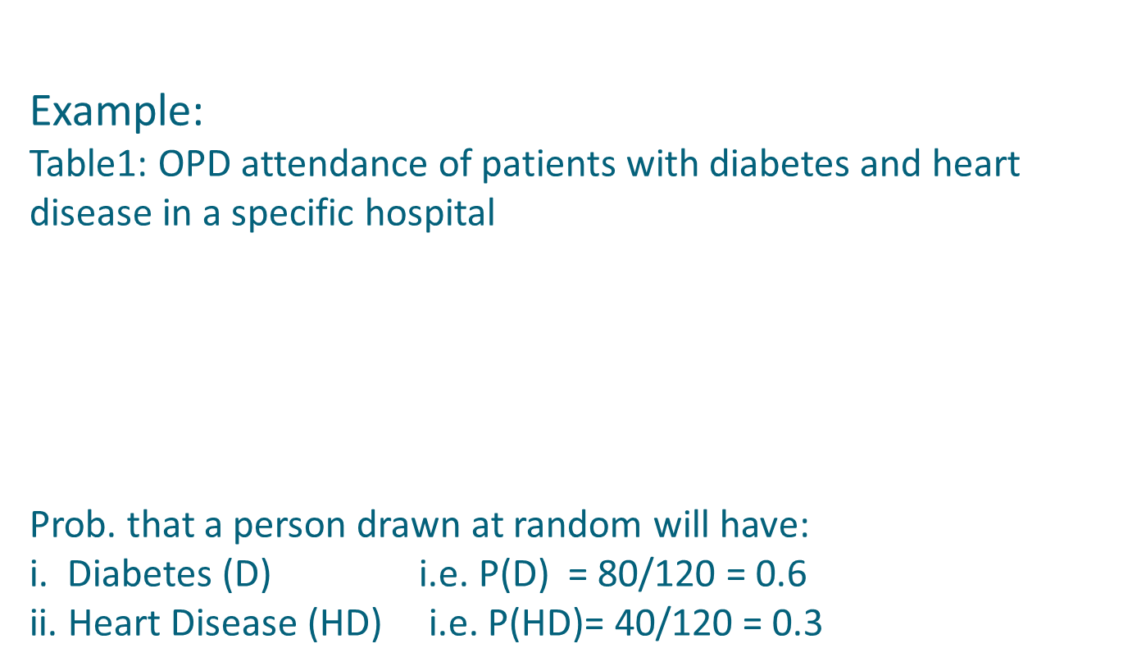
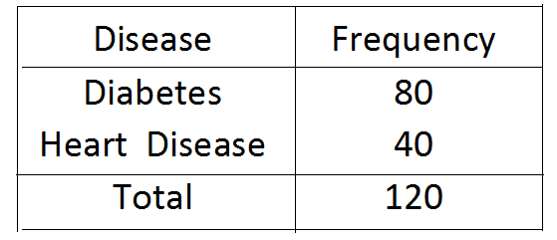

Slide 11
A bag contains 4 white and 6 red balls. A ball is drawn at random from the bag. What is the probability that it is red? White?
Solution: A be the event that the ball is red
B be the event that the ball is white
n(S)=10 , n(A)= 6 , n(B) = 4.
P(A)= n(A)/n(S) and P(B)= n(B)/n(S)
=6/10 =4/10
= 0.6 =0.4

Slide 12
An ordinary die is rolled once. Find the probability that an even number occurs. Also find a number greater than 4 occurs.
Solution: Let, S= {1,2,3,4,5,6}
A= event of even numbers= {2,4,6}
B= event of numbers greater than 4= {5,6}
P(A)= n(A)/n(S) and P(B)= n(B)/n(S)
=3/6 =2/6
=0.5 =0.3

Slide 13
Properties
1. Since probability is expressed in terms of relative frequency or proportion, it can take values between 0 and 1.
2. value ‘0’ means that the event cannot occur.
A value ‘1’ means that it is certain to occur.
3. A value ‘0.5’ means that the event has equal chance of occurrence. It has smaller chance of occurrence as it approaches ‘0’.
4. The sum of the probability (relative frequencies) of all the events must be equal to 1 or 100%.

Slide 14
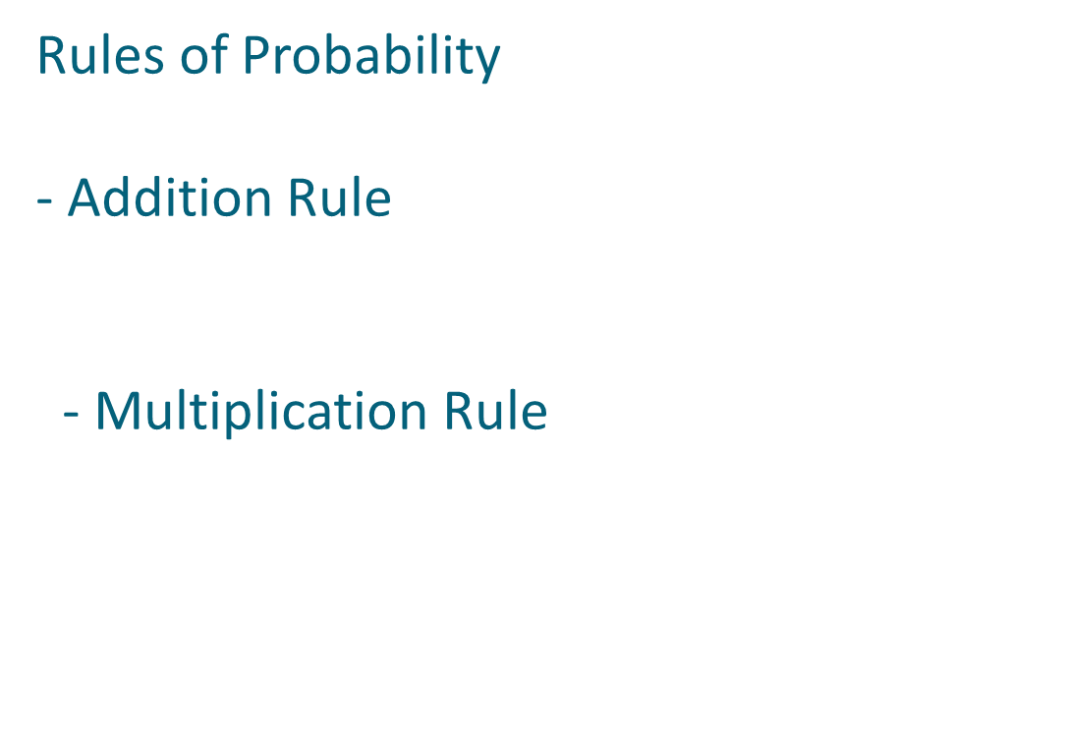

Slide 15
Rules of probability
Addition Rule:
a. Let us consider, A and B are two mutually exclusive events, than the probability that either A or B will occur is,
P(A or B) = P (A) + P (B)
A B

Slide 16
Example 1
Table 2: Students in Different Departments in DIU
Department No. of Students
Statistics 50
Mathematics 30
ETE 20
others 50
Total 150
P(Stat or Math) = P(S 0r M) = P(S) + P(M)
= 50/150 + 30/150
= 80/150
= 0. 53

Slide 17
b. For mutually non-exclusive events
a
b
AB
A
B
Let us consider, A and B are two mutually non-exclusive events, than the probability that either A or B will occur is,
P(A or B) = P (A) + P (B) – P (A and B)

Slide 18
Example 2
Problem:
The probability that a student passes statistics is 2/3 and he passes mathematics is 4/9.If the probability of passing both courses is 4/5, what is the probability that, he will pass at least one courses?
Solution:
By addition law(mutually non exclusive)
P(S or M)= P(S)+ P(M)- P(S and M)
= 2/3 + 4/9 - 4/5
=14/45
=0.311

Slide 19
Rules of probability
Multiplication Rule
a. For independent events
P(A & B) = P (A). P (B)
or
P(B).P(A)
b. For dependent events
P(A & B) = P (A). P (B/A)
or
P(B).P(A/B).
P(A), P(B) are called Unconditional prob.
P(B/A) is Conditional prob.
P(A & B) , P(A or B) are joint prob.

Slide 20
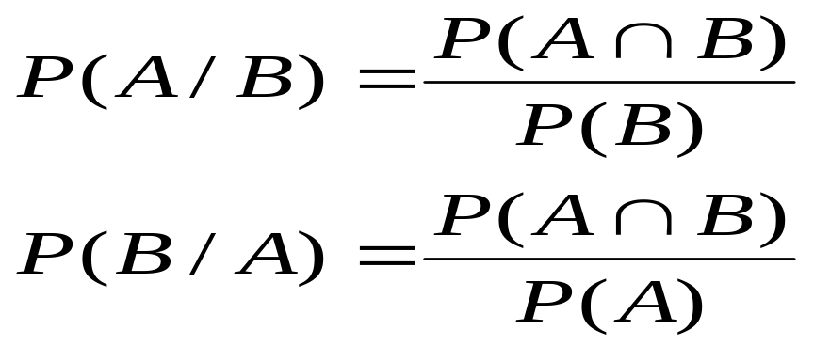
Conditional probability
Conditional probability is the probability of an event ( A ), given that another ( B ) has already occurred.
If the event of interest is A and the event B is known or assumed to have occurred, "the conditional probability of A given B“, is usually written as P(A|B).

Slide 21
Problem
A pair of dice is thrown. Find the probability that sum of the points on the dice is 10 or greater if a 5 appears on the first die.
Solution: Let, A be the event that sum of the points on the two dice is 10 or greater
B be the event that a 5 appears on the first die.
Now, A={(4,6),(5,5),(5,6),(6,4),(6,5),(6,6)} P(A)=6/36
B={(5,1),(5,2),(5,3),(5,4),(5,5),(5,6)} P(B)= 6/36
A∩B ={(5,5),(5,6)} P(A ∩ B)=2/36
Hence, P(A/B)= (2/36)/(6/36)
= 1/3

Slide 22
Marginal probability
These terms are dubbed "marginal" because they used to be found by summing values in a table along rows or columns, and writing the sum in the margins of the table.
Marginal probability is the probability of the occurrence of the single event.

Slide 23
Joint probability
Joint probability is the probability that two or more events will occur simultaneously.
A∩B, B∩C, A∩B∩C, A∩B∩………∩n are joint events. Probability of these events P(A∩B), P(B∩C), P(A∩B∩C),P (A∩B∩………∩n) are called joint probability.

Slide 24
Problem on Independent event
Let us consider a table of probabilities of gender and faculty of the students where both are independent of each other.
Faculty | Gender |  | Total
 | Male | Female
Commerce(C) | 0.18 | 0.12 | 0.30
Humanities (H) | 0.42 | 0.28 | 0.70
Total | 0.60 | 0.40 | 1.00

Slide 25
Solution:
Events are independent if
P(F∩C)= P(F)* P(C)
P(M∩H)= P(M)*P(H)
P(F∩H)= P(F)*P(H)
So, P(F)= 0.4
P(C)= 0.3
P(F)*P(C)=0.12
P(F∩C)=0.12
P(F∩C)= P(F)* P(C)
So, event F and C are independent.

Slide 26
Problem on mutually exclusive event
If a and b are two events , then they are mutually exclusive if, P(AUB)= P(A)+P(B)
If not, then P(AUB)≠P(A)+P(B)
If there are more then two events, like n times

Slide 27
Table3: Results of a Standard and experimental diagnostic test
Test Result D ND Total
TP 7 4 11
TN 3 86 89
Total 10 90 100

Slide 28
P(D) = 10/100 = 0.1
P(TP) = 11/100 = 0.11
P(D/TP) = 7/11=0.64
P(TP & D) = P(TP) . P(D/TP)
= 11/100 . 7/11 = 7/100 = 0.07
P(TP or D)= P(TP) + P(D) – P(TP & D)
= 11/100 + 10/100 –7/100
= 14/100
= 0.14

Slide 29
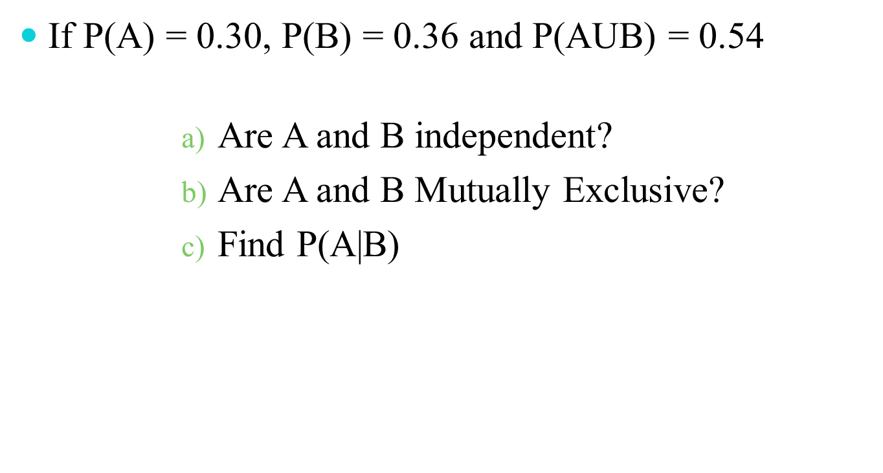

Slide 30


